Slide 1
Housing Price Indicator
Capstone Project

Slide 2
Introduction
For a lot of people, buying a house is a tremendous investment and a big step of moving forward in life. However, with no resources or personnel to help, the process of picking one that is right for you could be a daunting task, this project aim to build a accurate model, to showcase factor that may or may not have impact on housing prices.
Using data listed below, a housing dataset in the US, this dataset has different data regarding attribute regarding to the building such as view, floors, condition, year build and year renovated etc.. Giving us a foundation to build our model.

Slide 3
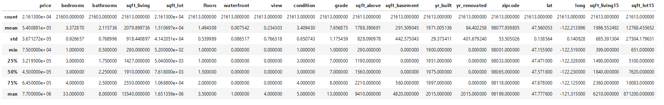
Methodology

Slide 4
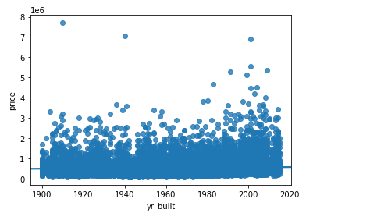

Figure 1 - Price and Build year

Slide 5
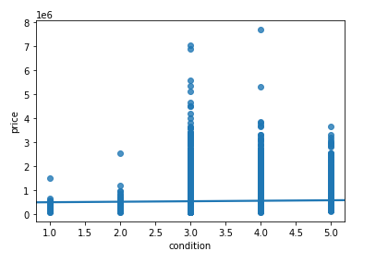

Figure 2 - Price and Condition

Slide 6
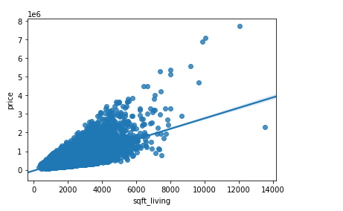

Figure 3 - Price and Square Feet

Slide 7
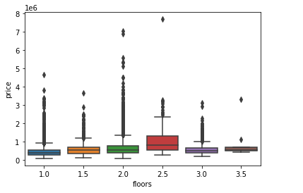

Figure 4 - Price and Floors

Slide 8
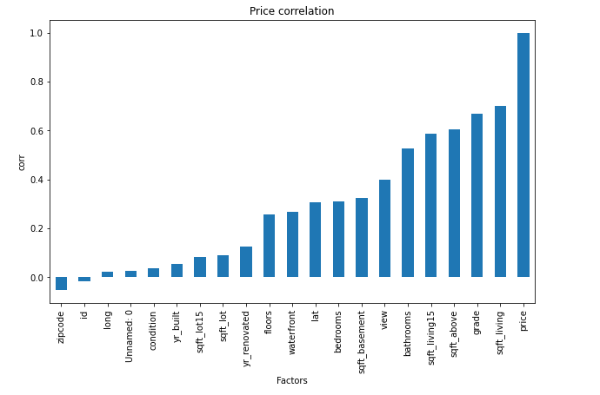

Slide 9
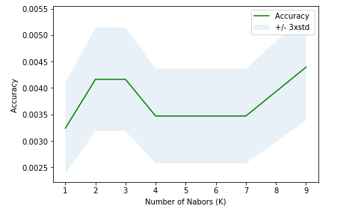
KNN

Slide 10
From this report, we explored the data available in this data set and identified buildings' price and other attributes, it may come as a contradiction, however, we found that there are little relation between price and the amount of floors the building has. Building size(living and upper floor) and grade of the build, this three factores have the highest correlation with price. We also used K-Nearest Neighbors to attempt in clusting.

